Slide 1

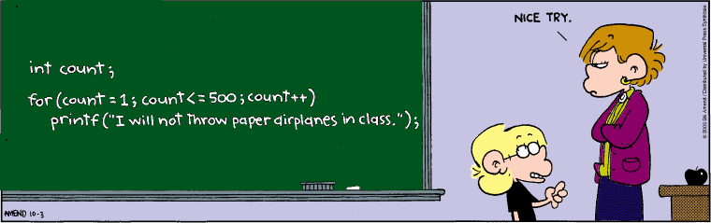
Programming
Programming concepts:
Conditionals & Loops
Notes:
Webinar – saw some examples of loops and used to solve some problems involving repetition

Slide 2
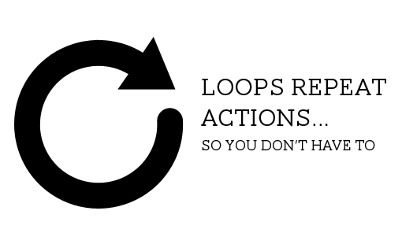
Learning Objectives
Boolean test (expression) – true/false
Used by All these :
For Loop – determinate Loop
Repeats a set of commands a specific number of times
While loop – Indeterminate Loop
Repeats while a test is true
Conditional : if elseif else
Pseudocode – problem step written in English
Help to design/write code
Solve problems
We’ll use while
later in the course
Notes:
Boolean expression – something that equates to true or false
For loop, while loop and conditional statements All use boolean expressions

Slide 3
Boolean expressions
Expression which is : True or False
Used to test something, e.g. compare two values
x == 50
Syntax
Can be combined with Boolean AND, OR, NOT etc
a == b | Value in a equal to b | if (x == 20) if (x1 == x2)
a < b | Value in a smaller than b | if (x < 0) if (x1 < x2)
a > b | Value in a greater than b | if (y > height) if (y1 > y2)
a <= b | a smaller than or equal to b | if (y <=0 )
a >= b | a greater than or equal to b
a != b | a not equal to b
&& | AND
|| | OR
! | NOT

Slide 4
Boolean expressions
(20<=40)
!(50==(45+5))
(20>10 && 10>=15)
!(30<=20 || 50>=40)
(20>=10 && !(10>=15))
In a program the values would be
stored in variables, e.g.
if (x<=0 || x>=width)

Slide 5
While Loops
Keep repeating block while Boolean expression is TRUE
int x=5;
while( x != 10 )
{
ellipse(i*10, 50, 10, 10);
x=x+1;
}
If test expression isn’t true, skips straight to end
Otherwise repeats tasks while expression is true

Slide 6
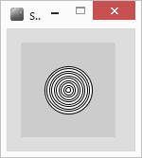
For Loop : Example
Want to draw concentric circles
int size=50;
for(int i=0; i<10; i++)
{
ellipse(50,50,size,size);
size=size-5;
}
Note : for loop has no ; uses the braces { }
commands inside are repeated
Notes:
No ; at the end – the braces are there instead

Slide 7
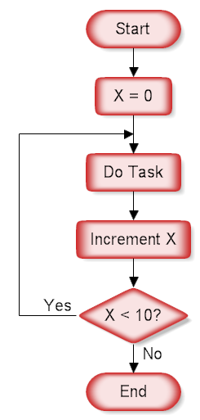
For Loop : syntax
for( int i=0 ; i<10 ; i++ )
Always use a variable – typically a counter i
For – 3 parts, divided by ‘;’
int i = 0 variable starting value(s)
i is a counter with an initial value of 0
i<10 end condition – keep going while true
If value in i is less than 10 keep going
i++ Do this each time around the loop
Add 1 to value in i (increment)
could also be written i=i+1

Slide 8
Example 1st Loop
drawing concentric circles
int size=50;
for(int i=0; i<10; i++)
{
ellipse(50,50,size,size);
size=size-5;
}
0
50
i
size

Slide 9
Another example
int size;
for(size=50; size>0; size=size-5)
{
ellipse(50,50,size,size);
}
What would this do?

Slide 10
For Loops – how many loops?
for(int i=1;i<=5;i++) //smaller than or equal to
{
//do task
}
for(int x=10;x<50;x=x+10)
{
//do task
}
for(int c=10;c>5;c--)
{
//do task
}

Slide 11
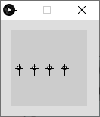
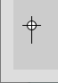
Draw 4 crosses
float x=10;
float y=50;
ellipse(x,y,5,5);
line(x-5,y,x+5,y);
line(x,y-5,x,y+10);
Draws a celtic cross
centre at x,y
float x=10;
float y=50;
ellipse(x,y,5,5);
line(x-5,y,x+5,y); // Draw cross
line(x,y-5,x,y+10);
PseudoCode – English

Slide 12
For Loop : Run time errors
Infinite loop – goes forever
Why?
for(int i=0; i>=0; i++)
for(int i=0; i != 10; i=i+3) //i not equal to 10
for(int i=0; i < 10; i++);
{ point( x+(i*10), 50); }
how many points?
Notes:
1, semi colon, command not inside the loop

Slide 13
Conditional
Conditional statements
if (something is true)
{ do some commands
}
elseif (something is true)
{ do some commands
}
else
{ do some commands
}

Slide 14
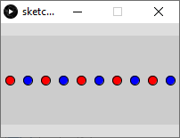
Conditional inside loop
How would we produce this?
20 ellipses
Even numbers blue, odd are red
Modulous operator %, (number%2 == 0)
Divide by 2 but keep the remainder

Slide 15
While vs For
Use For loop when you know how many times you want to perform a task
Use while loop when you don’t know how many repetitions
While something is true
Example want to draw crosses all across the screen (width is 100)
while (crossX < 100)
{
//draw cross at crossX
// move right a bit
}

Slide 16
Summary
Boolean expressions : TRUE, FALSE
AND - &&
OR - ||
NOT - !
Conditionals : if( ) else if( ) else if( ) else
While loop : repeat code block while expression is true
For loop : repeat code block a specific number of times

